Slide 1
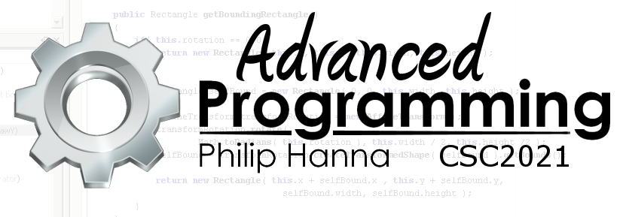
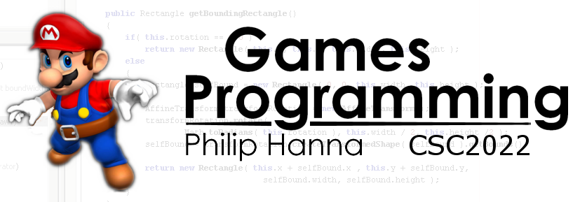
Particle Systems
Delivering special effects using particle systems

Slide 2

Particle Systems

Slide 3
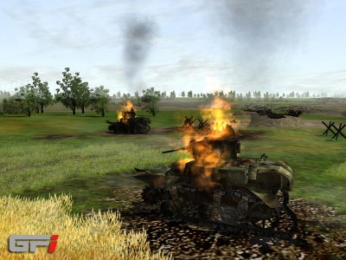
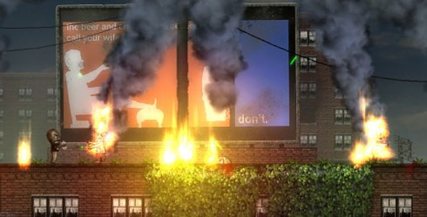
A particle system can be used to simulate phenomena such as fire, smoke, explosions, moving water (e.g. fountains, waterfalls), sparks, dust, snow, rain, bullet casings, etc.
Particle systems can also be used to provide special effects for spells, etc. Particle effects are widely used within games.

Slide 4
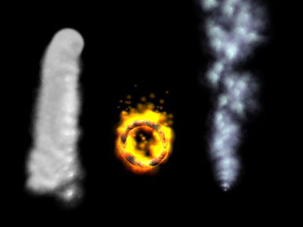
A particle system is controlled by an emitter. The emitter generates particles. Particles may be emitted at a constant rate or in sudden bursts.
Each update/draw is defined by a simulation stage and a rendering stage.
Each generated particle can have a number of parameters, e.g. velocity, direction, lifetime, colour, etc.
Typically each parameter value is randomly selected from within some defined range.

Slide 5
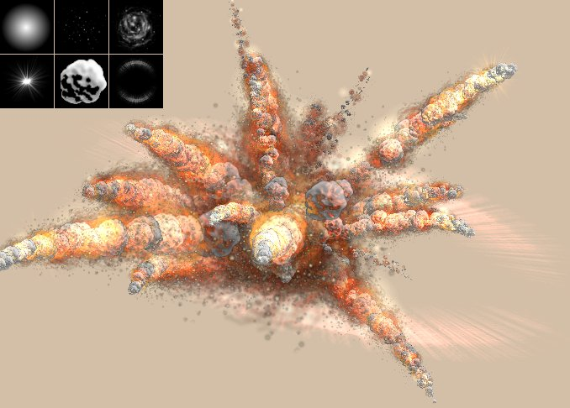
Simulation Stage
Spawn new particles if needed. Remove any particles that exceed their lifetime.
Update particles properties (e.g. position, rotation, etc.) based on the simulation rules. If desired, test particles for collision against other objects.
Rendering stage
Render each particle (if in 3D typically using a textured billboard)

Slide 6
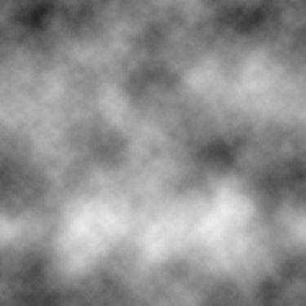
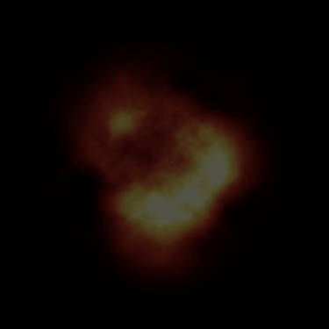
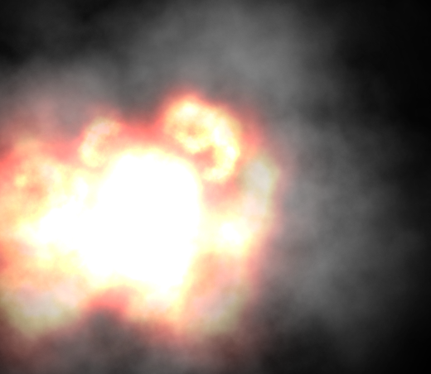
: Particles
Each particle system comprises a number of particles. Each particle is defined with properties such as position, velocity, acceleration, rotation, lifetime, etc.
When drawn each particle will display a common image that is layered on top of other particles (using either normal or additive blending).
The particle properties are controlled to provide the desired effect.

Slide 7
: Particle Management
Particle System
Explosion Particle System
Explosion Smoke Particle System
Smoke Plume Particle System
Particles should be cached and reused as they die and are reborn (to reduce garbage collection churn).
It may be necessary to manage the total particle load within the emitter.
The order in which particle effects are drawn can be important (particles to be combined using normal alpha blending need to be draw first, with additive blending second).
Some emitters may only manage a single particle effect, others might manage a number of different effects.

Slide 8

Key takeaways:
Particles systems can offer many forms of visually impressive effects and are very commonly used within games.
In essence, a particle system simply draws a small number of images multiple times to generate the desired effect.

